Slide 1

Programming and Data Visualization for Researchers
[HEL-8048]
Workshop 2
James McCutcheon
IPS / Helsefak

Slide 2
Extra material on Python fundamentals
Types of variable (e.g. strings, integers, lists)
For-loops
Conditional statements (if-else)

Slide 3

Modules, packages and libraries
The Tidy Kitchen Analogy
  Modules are like the appliances in a kitchen
  Some modules are always there (e.g., the fridge, the stove top)
  Other modules you only get out of the cupboard when you need to use them (e.g., the waffle iron)
  Some modules you have to go and “buy” if you don’t already own them (e.g., a smoothie maker)
Installing a module is like going to “buy” it (but you don’t have to pay!)
Importing a module is like getting it out of the cupboard

Slide 4
Modules and packages
Modules and packages allow you to add new possibilities to basic “vanilla” Python
A package is just a collection of modules
Using a module in your script involves two steps:
  Installing it (if you don’t already have it)
  Importing it into your script

Slide 5
Importing a module
import numpy
ages = [21, 33, 24, 21, 67, 43, 23]
numpy.mean(ages)

Slide 6
Importing a module
import trompy

Slide 7
Installing a module
Need to use the command line interface (CLI) *
  aka the terminal aka the shell aka the command prompt
First step is to open an Anaconda prompt…

Slide 8
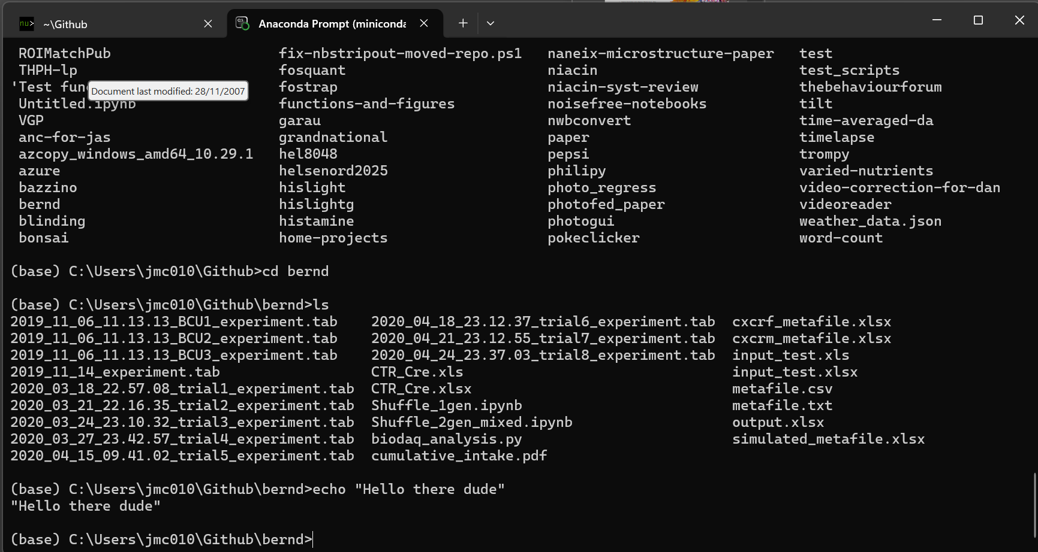
The terminal
Allows you to interact directly with your computer’s operating system

Slide 14
Installing a module
Need to use the command line interface (CLI) *
  aka the terminal aka the shell aka the command prompt
First step is to open an Anaconda prompt…
pip install trompy
Can also use Anaconda to install many packages, e.g. conda install …
Can see packages at pypi.com
Best way to find out how is to google “install [packagename] in python”

Slide 15
Importing a module
import trompy
print(dir(trompy))
ages = [21, 33, 24, 21,, 67, 43, 23]
trompy.mean_and_sem(ages)

Slide 16
Loading data
Download the file “Pearson.txt” from Canvas
import numpy
filename = “path-to-file/Pearson.txt”
data = numpy.loadtxt(filename)
For this to work need to include numpy argument to skip rows. Also check name of the file, is it Pearson-1.csv?
There are many different sort of data files but some of the simplest and easiest to deal with are…
  .txt files and .csv files

Slide 17
Thinking about data structures
numpy data arrays are more spreadsheet-like
Can have one, two, three, or more axes
Indexing is similar but a bit different to lists
data[:,0] # selects all rows, first column
data[:,1] # selects all rows, second column
data[5,:] # what does this select?

Slide 18
Thinking about data structures
Use the cheat sheet to try out some different numpy functions on the provided data
Can also assign a subset of the data to a new variable to make it easier
fathers = data[:,0] # can assign to a new variable
fathers.shape
Use the cheat sheet to try out some different numpy functions on the provided data or a subset of it, e.g….
  len
  shape
  sort
  numpy.mean
  numpy.median

Slide 19

COFFEE TIME

Slide 20
Plotting some data
import matplotlib.pyplot as plt
Note: This is an example of using an alias when importing a package or module. It saves you from writing matplotlib.pyplot… everything time you want to use it
fig, ax = plt.subplots() # makes a new figure and axis
ax.hist(fathers) # makes a histogram
Try plotting different data, e.g.
  heights of the sons
  only the heights over a certain threshold

Slide 21
Plotting some data
fig, [ax1, ax2] = plt.subplots(ncols=2) # two subplots
ax1.hist(fathers, color=“green”)
ax2.hist(sons, color=“blue”)
Try ax1.hist? to see the available options. Also just google “matplotlib hist”
Try adding the bins argument to ax1.hist
Try making a scatter plot with fathers and sons heights (hint: ax.scatter(… )
Try making a figure with different layout, e.g. two rows instead of two columns

Slide 22
COFFEE TIME

Slide 23
Variables: Strings
my_name = jaime
Strings need quotation marks
Both single or double work but best to be consistent
my_name = “jaime”

Slide 24
Variables: Strings
1st_name = “jaime”
Variables cannot start with a number (or another illegal character)
first_name = “jaime”

Slide 25
Variables: Strings
firstName = “jaime”
In Python the convention is to use snake_case
Using camelCase as shown here will not break your code but it is better to follow the conventions when possible
Many other languages use camelCase, e.g. Java
first_name = “jaime”
https://khalilstemmler.com/blogs/camel-case-snake-case-pascal-case

Slide 26
Variables: Strings
n1 = “jaime”
Python is intended to be readable so it is recommended to use descriptive variable names unless the variable has a very limited scope
Sticking to Python conventions is sometimes called making your code “pythonic”
first_name = “jaime”

Slide 27
Variables: Strings
first_name = “jaime”
second_name = “mccutcheon”
full_name = first_name + second_name
Variable types have different functions and methods that can be used on them
Try some of the string methods from the cheat sheet
Try the line below. Does it work and, if not, why not?
numeric_name = float(first_name)

Slide 28
Variables: Examining variables
first_name = “jaime”
print(type(first_name))
type shows you what type of variable
What does dir show you?
print(dir(first_name))

Slide 29
Variables: Numeric and Boolean types
Spend some time experimenting with integers, floats, and booleans
Try converting different variables to different types
Use type and dir to investigate them
What is wrong with the following code blocks…?
my_boolean_value = true
x = 2
y = “four”
print(x + y)
A = 2
B = 4
print(a + b)

Slide 30
Variables: Lists
names = “Jaime”, “Jayla”, “Loudon”, “Booker”
To make a list you enclose a set of items in square brackets
You can also make an empty list, which comes in handy sometimes
names = [“Jaime”, “Jayla”, “Loudon”, “Booker”]
empty_list = []

Slide 31
Variables: Lists and indexing
names = [“Jaime”, “Jayla”, “Loudon”, “Booker”]
print(names[1])
You can select items in a list using square brackets after the list
This is called indexing
In Python indexing starts at [0]
What does the index [-1] do?

Slide 32
Variables: Lists
names = [“Jaime”, “Jayla”, “Loudon”, “Booker”]
names.append(“Oliver”)
names.append(“Little Miss”)
One of the most important list methods is append, which adds items to the end of a list
len is also very useful and gets the length of the list
print(len(names))
Try experimenting with some of the other list methods on the cheat sheet

Slide 33
For-loops
When we are programming we often want to do the same operation on many bits of data
This is one of the main ways that computers and coding can save us time
For example, if we had the ages (in years) of a group of people we might want to convert this into ages in months
ages = [43, 43, 12, 11]

Slide 34
For-loops
ages = [44, 44, 13, 12]
print(ages[0] * 12)
print(ages[1] * 12)
print(ages[2] * 12)
print(ages[3] * 12)
Without a for-loop, we can do this but it is a bit annoying even with only four family members. Imagine if you wanted to do the same thing for every UiT student or staff member.

Slide 35
For-loops: basic syntax
for item in list:
do something
Note 1: the item is a new variable you are making that exists while the loop is running and afterwards. Make sure you don’t use the same name as another variable in your script and call it something readable.
Note 2: you can use for-loops on some other types of variables but not all types; we can discuss this later
Note 3: the indenting is very important and Python uses it to tell it when the for-loop ends
https://www.youtube.com/watch?v=SsoOG6ZeyUI

Slide 36
For-loops
ages = [44, 44, 13, 12]
for current_age in ages:
print(current_age * 12)
What if you want to store age in months in a new list?
ages = [43, 43, 12, 11]
ages_in_months = []
for current_age in ages:
ages_in_months.append(current_age * 12)
print(ages_in_months)

Slide 37
For-loops
weights_in_kg = [76, 55, 89, 115, 67]
Write a for-loop that converts the list of weights_in_kg above into weights in pounds (lbs). Hint: 1 kg = 2.2 lbs
If you finish early, investigate the following…
  What data types can you use a for-loop with?
  What does the function enumerate do and how would you use it in a for-loop
  What does the function zip do and how would you use it?
  Write a for-loop that calculates the mean of the data.

Slide 38
Conditional statements (if-else)
Conditional statements are a fundamental concept in programming
if something_is_True:
do_something
Note 1: The part something_is_True above can be any statement that produces a Boolean value
Note 2: Just like with a for-loop, the indenting is very important here

Slide 39
Conditional statements (if-else)
name = “Paul”
name in [“John”, “Paul”, “George”, “Ringo”]
a = 6
a < 10
cat = “Oliver”
cat == “Oliver”
Try changing the code to generate False instead of True
Try using different operators

Slide 40
Conditional statements (if-else)
if something_is_True:
do_something
name = “Paul”
if name == “Paul”:
print(“That is a boring name”)
Try changing the code so that you have a list of boring names that you can check against

Slide 41
Conditional statements (if-else)
Can also have a section to tell the program to do something else
if something_is_True:
do_something
else:
do_something_else

Slide 42
Conditional statements (if-else)
name = “Paul”
if name == “Paul”:
print(name, “is a boring name”)
else:
print(name, “is a bit more exciting than Paul”
Note: Here, I have added the variable, name, to my print statement

Slide 43
Conditional statements (if-else)
Can include multiple checks using elif
if something_is_True:
do_something
elif something_different_is_true:
do_something_different
else:
do_something_else_different

Slide 44
Conditional statements (if-else)
name = “Paul”
if name == “Paul”:
print(name, “is a boring name”)
elif name == “Ringo”:
print(name, “is an awesome name”
else:
print(name, “is OK but it’s not as good as Ringo”

Slide 45
Conditional statements (if-else)
Conditional statements are often used together with for-loops
names = [“John”, “Paul”, “George”, “Ringo”]
for name in names:
  if name == “Paul”:
  print(name, “is a boring name”)
  elif name == “Ringo”:
  print(name, “is an awesome name”
  else:
  print(name, “is OK but it’s not as good as Ringo”
If this is getting confusing, try running in debug mode and watching how the code moves from line to line and how the variables change
Try looping through a list of numbers instead of strings

